Slide 1
YouTube API Scraping: Insights from Top Data Science Channels
BY : IMTIAZ FARUK

Slide 2
Agenda
Introduction to API
Why YouTube API
Description of My Analysis
Different Visuals
Hypothesis
Challenges and Learnings

Slide 3
Overview of the project :
Find out the insights from the Channels ( such as number of Subscribers, number of Views, Total Views
Find out insights from each videos (such as Title, Published Date, Count of Likes, Comments, Duration of each Videos
Hypothesis :
1) Does the number of likes and comments matter for a video to get more views?
2) Does the video duration matter for views and interaction (likes/ comments)?

Slide 4

API : (Application Programming Interfaces)
set of rules and protocols that allow different software applications to communicate with each other
Used for integration between different systems and make development faster
Different types, e.g., Public, Private, Composite
Works with sending a request and response
Requires Authentication and Authorization
rate limits that control how many requests a user or application can make within a certain time period.

Slide 5


Why YouTube API?
High Performance and Scalability
Well
Documented
High Quota Limits
Secure Authentication
Strong Integration with other APIs

Slide 6
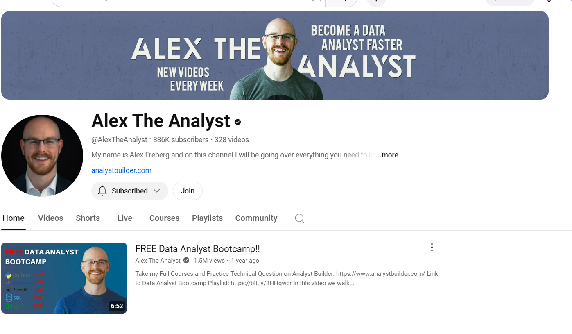
My Data : 10 popular Data Channels
1. Alex The Analyst

Slide 7
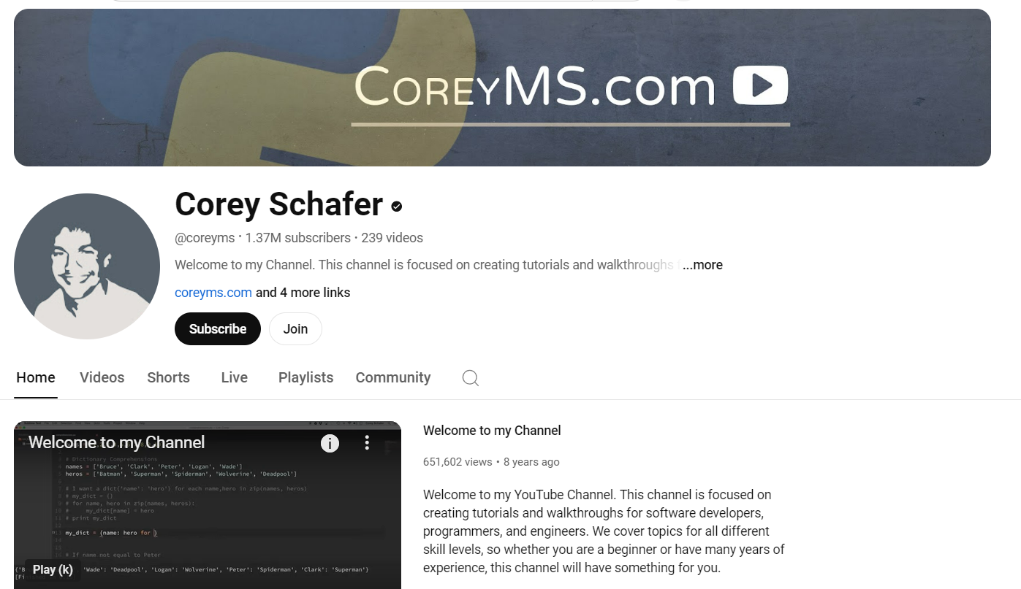
My Data : 10 popular Data Channels
2. Corey Schafer

Slide 8
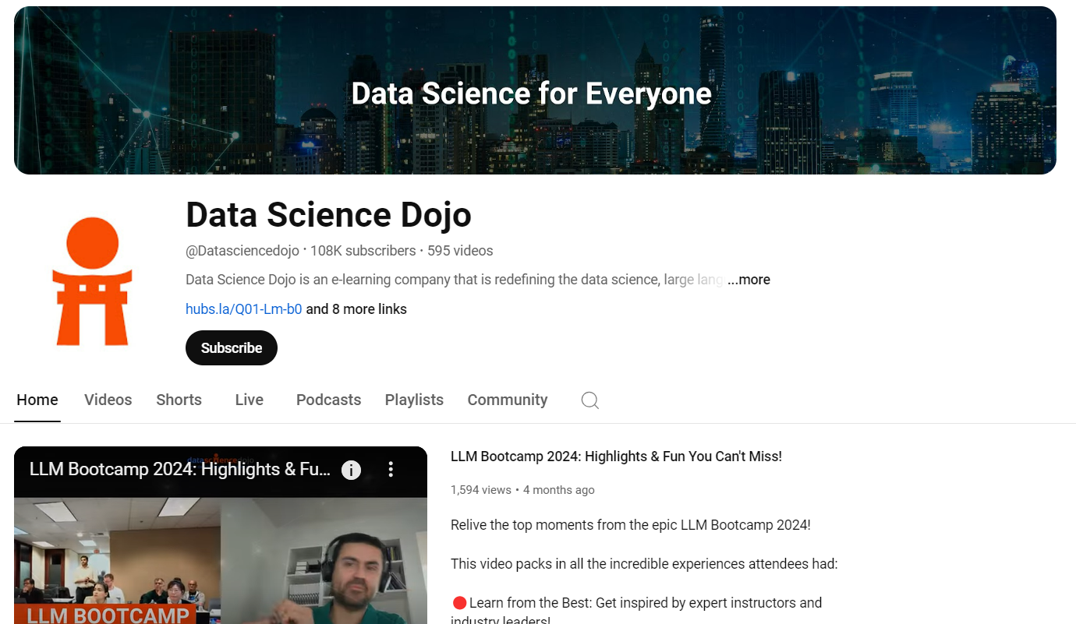
My Data : 10 popular Data Channels
3. Data Science Dojo

Slide 9
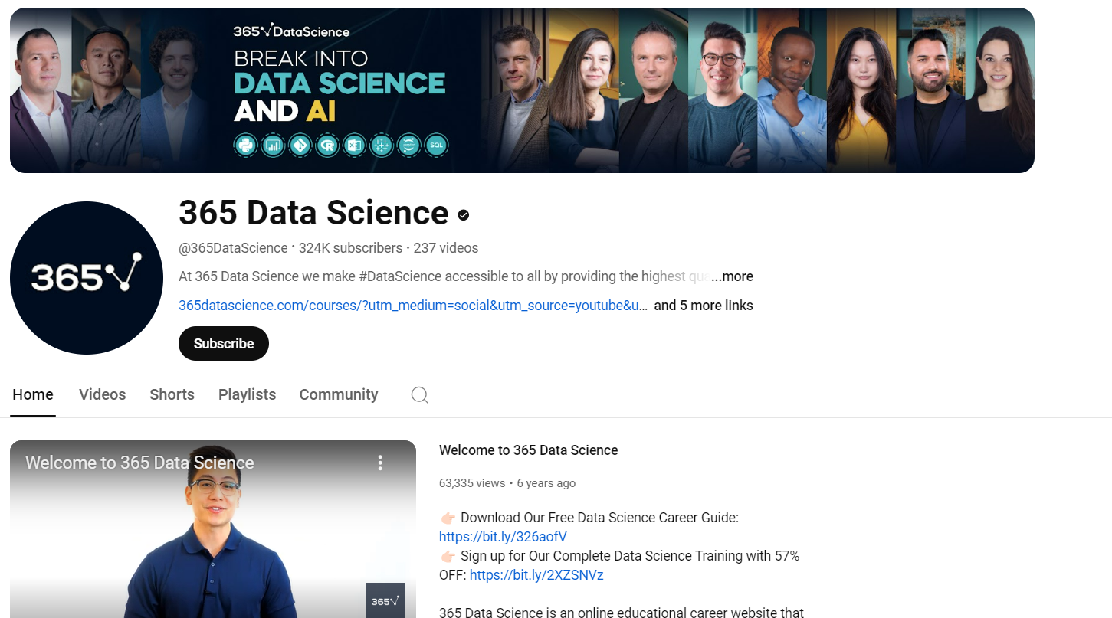
My Data : 10 popular Data Channels
4. 365 Data Science

Slide 10
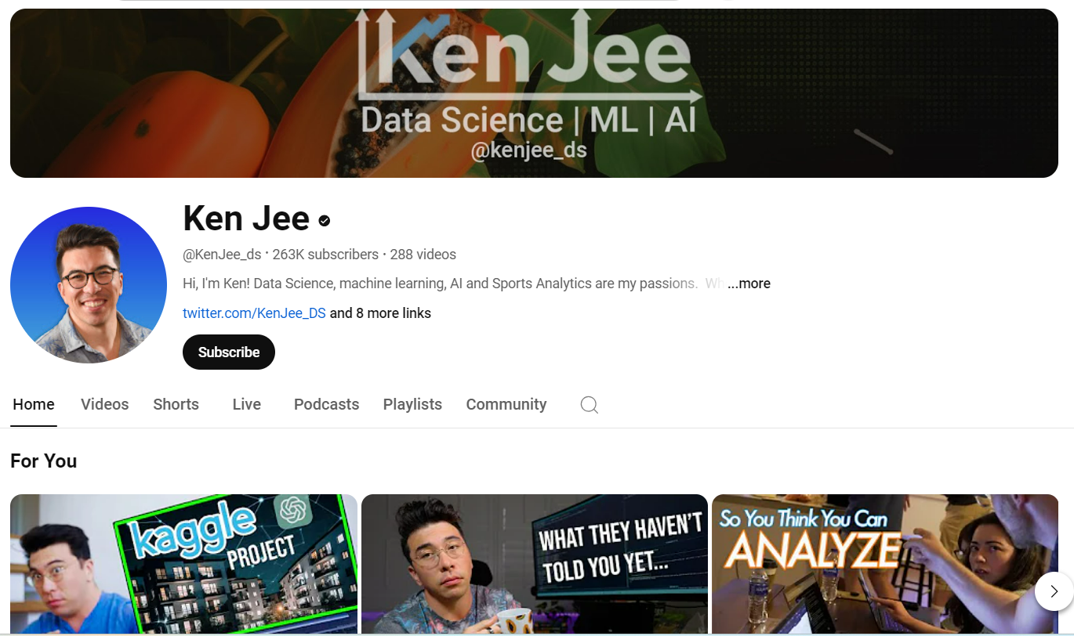
My Data : 10 popular Data Channels
5.Ken Jee

Slide 11
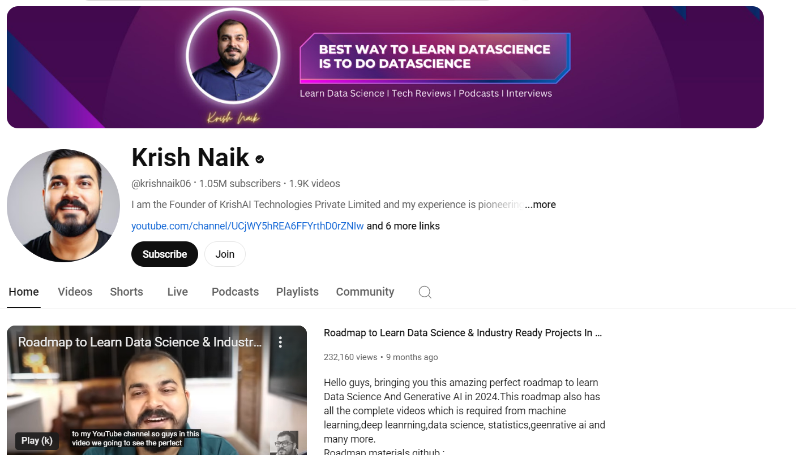
My Data : 10 popular Data Channels
6. Krish Niak

Slide 12
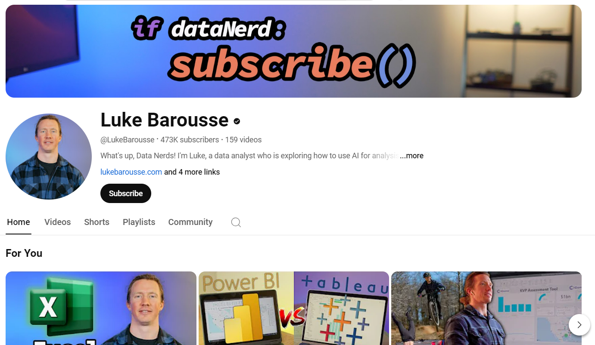
My Data : 10 popular Data Channels
7.Luke Barousse

Slide 13
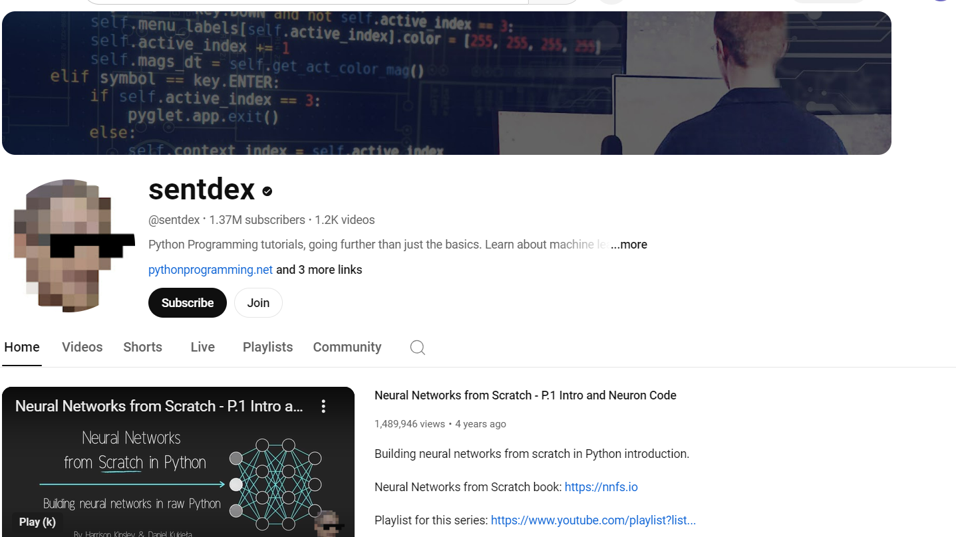
My Data : 10 popular Data Channels
8. Sentdex

Slide 14
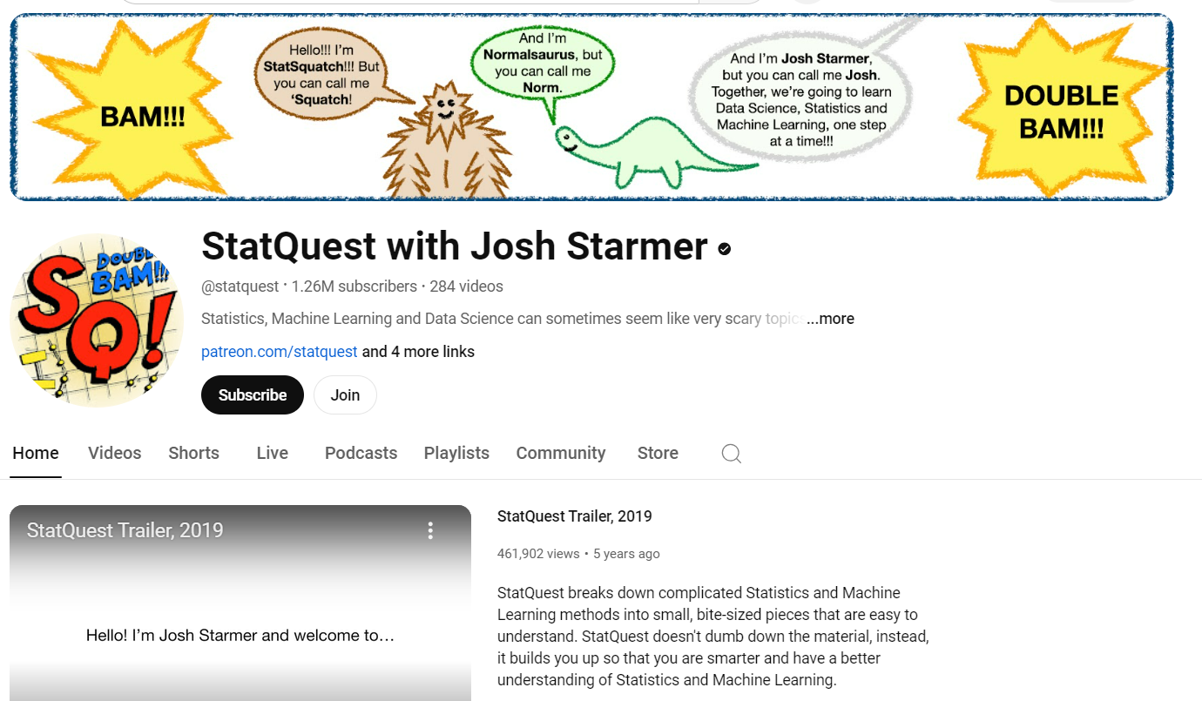
My Data : 10 popular Data Channels
9. Statquest with Josh Starmer

Slide 15
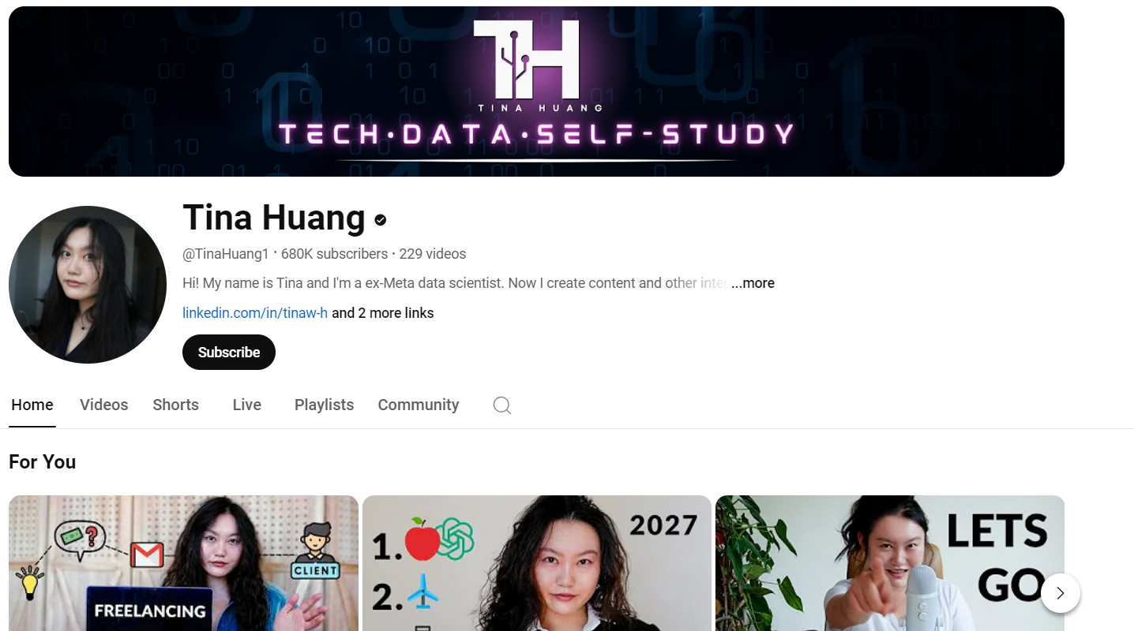
My Data : 10 popular Data Channels
10. Tina Huang

Slide 16
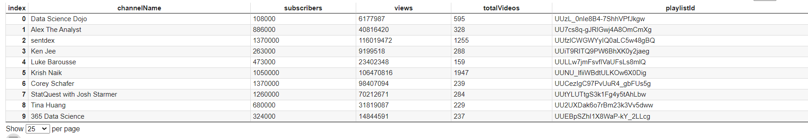
Channel Statistics Data Extraction

Slide 17
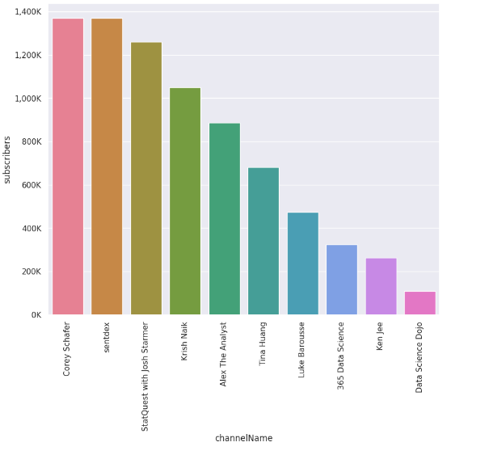
Plot for Subscribers

Slide 18
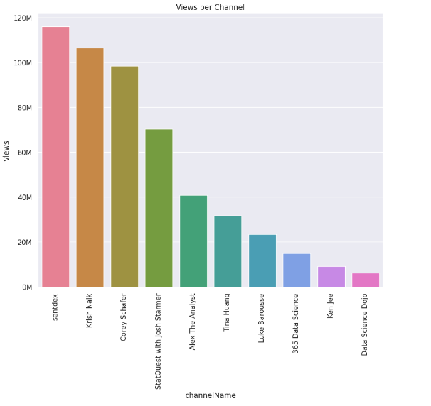
Plot for Views

Slide 19
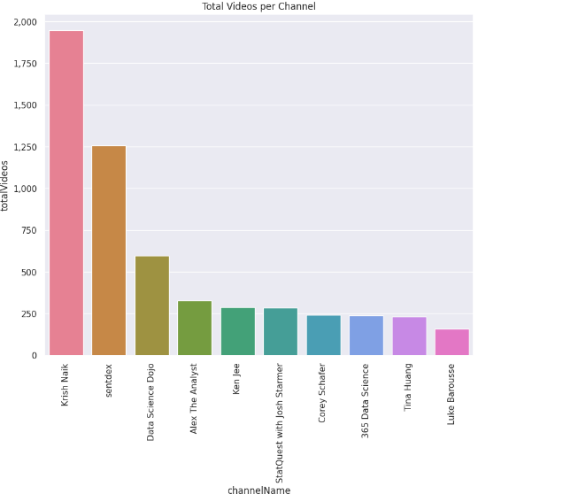
Plot for Total Videos

Slide 20
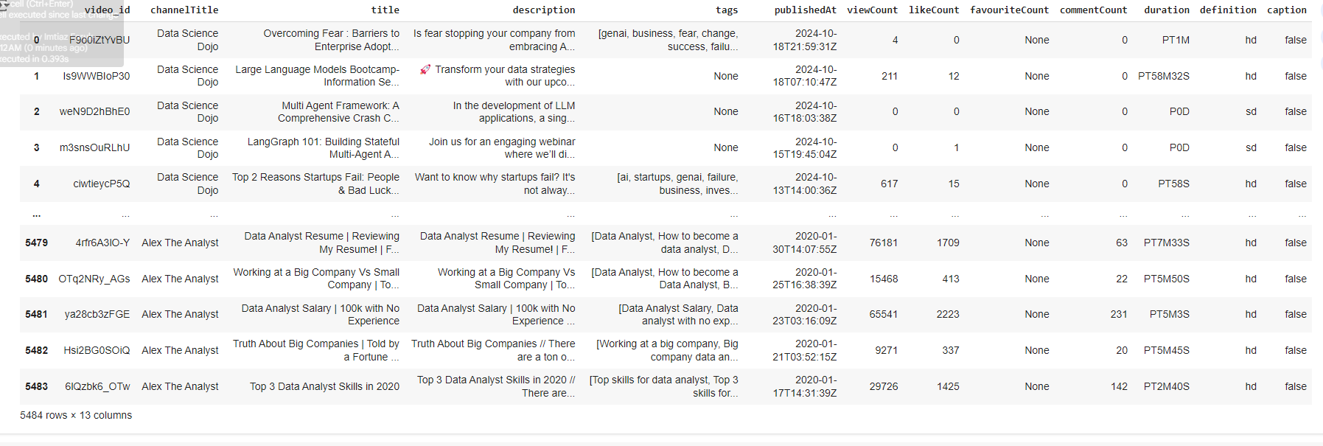
Data Manipulation and Result for each video

Slide 21
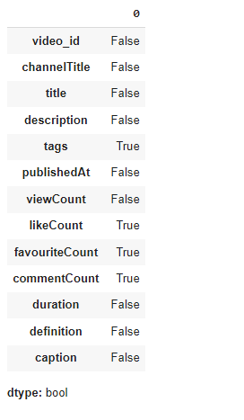
IsNull

Slide 22
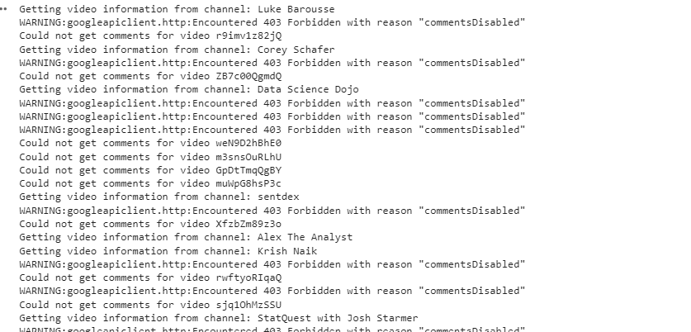
Outcomes for Fetching Comments (recovering errors)

Slide 23
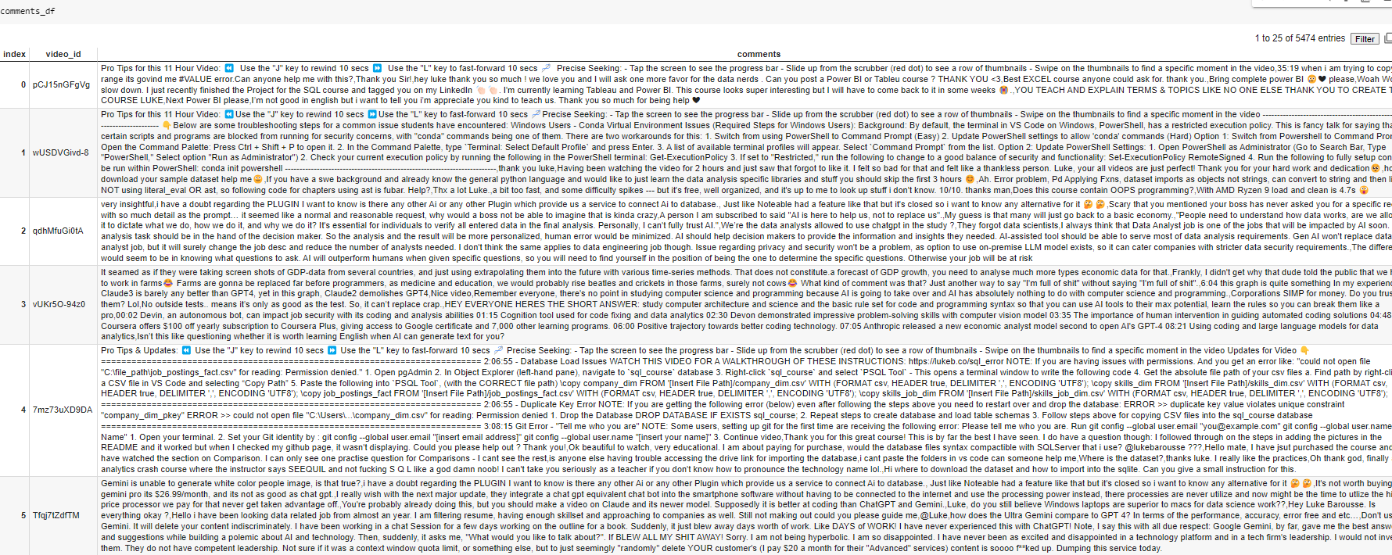
Outcomes for Fetching Comments

Slide 24
Hypothesis

Slide 25
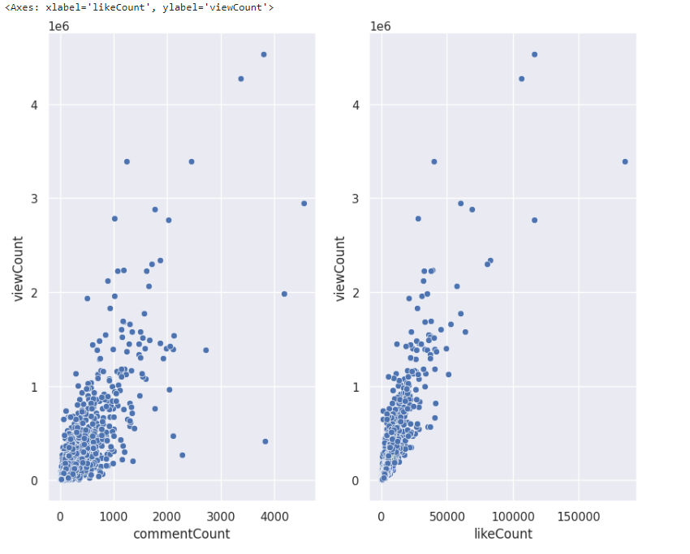
H1 : Does the number of likes and comments matter for a video to get more views?
1e6= 1 Million

Slide 26
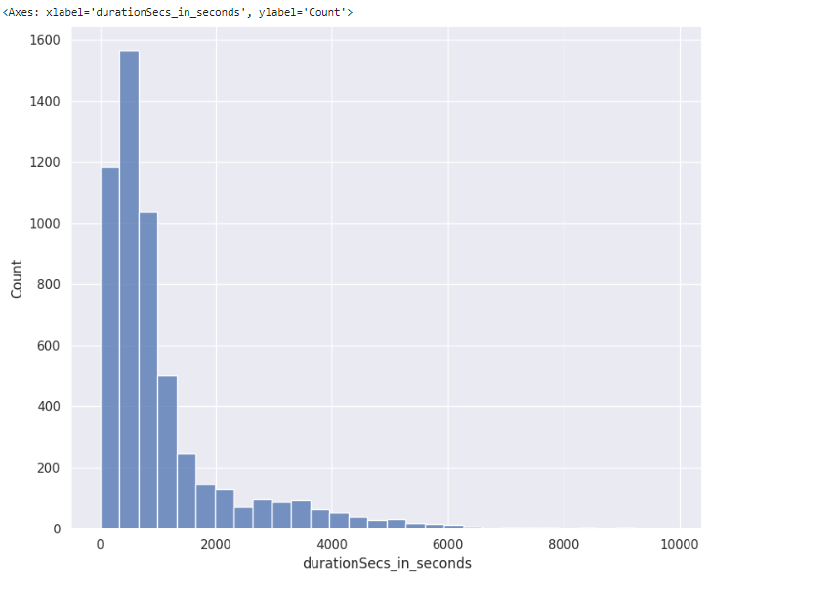
H2 : Does the video duration matter for views and interaction (likes/ comments)?
View count(k) with duration

Slide 27
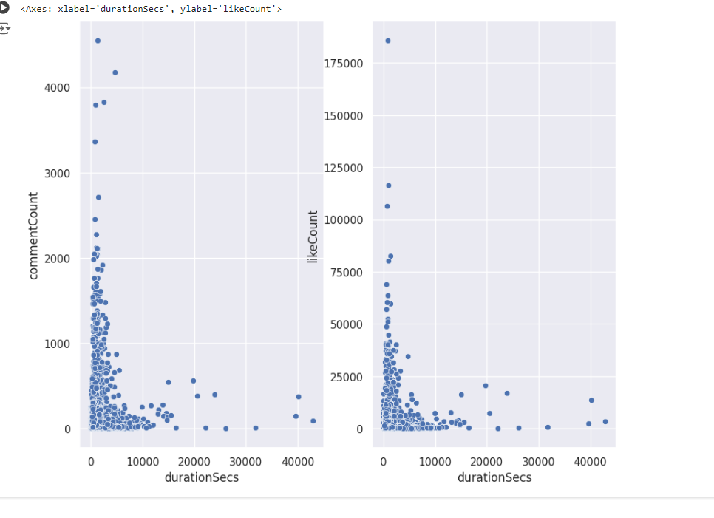
H2 : Does the video duration matter for views and interaction (likes/ comments)?

Slide 28
Challenges and Learnings
Choosing a better API ------ YouTube
Problems with the time and dates ------- Isodate Library
Problems with the comments (403, 404) ----- Error Handling :Try … Except

Slide 29
Thank you

